Slide 1


Who Wants to
Be a Millionaire?
Notes:
Lifeline icons on the question slides are hyperlinks which will take you to the lifeline screen. To return to the game, you may right click on the screen, choose Go, Previously Viewed. This should return you to the question slide. Alternatively, left click as usual to return to the game board, then click on the highest number that has been previously selected (in gold to indicate a followed hyperlink).
To utilize the 50:50 option, the moderator may tell the contestant which two options to disregard or, use Control-P to change the mouse arrow to a pen. Draw a line through two incorrect responses, then use Control-A to change the pen back into an arrow and continue with the game.
Clicking on the action button on the phone handset image of the Phone a Friend lifeline slide will hyperlink to the Ask Jeeves web site where the participant may ask for help.

Slide 2



1,000,000
500,000
250,000
125,000
64,000
32,000
16,000
8,000
4,000
2,000
1,000
500
300
200
100

Slide 3


Click to return to question, Cont-P to switch to the pen, cross out two incorrect answers, then Cont-A to switch back to pointer.

Slide 4

Click to return to the question and poll the class

Slide 5
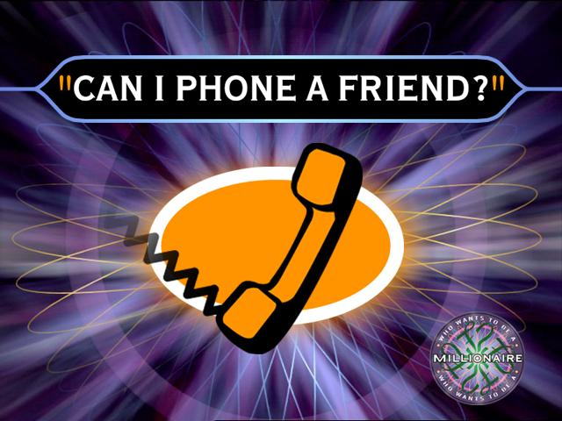
Click on link to Ask Jeeves, or click on this oval to return to question and ask a friend

Slide 6
Whats 1+1 =
A. window
B. 5
C. 3
D. 101

Slide 7
A. 100 answer
Back to Board

Slide 8
What's our class number times 5
A. 5
B. 10
C. 25
D. 20

Slide 9
C. 200 answer
Back to Board

Slide 10
What’s the colour of my heart
A. bright red
B. heart colour
C. dark red
D. hot red

Slide 11
B. 300 answer
Back to Board

Slide 12
How many class are in our school ?
A. 18
B. 256989
C. 0000001
D. 10

Slide 13
A. 500 answer
Back to Board

Slide 14
Whats 18 x 5
A. 80
B. 100,000,000
C. 120
D. 20

Slide 15
C. 2,000 answer
Back to Board

Slide 16
When is graim going to get maired?
A. yesterday’
B. don’t now
C. now
D. incorrect

Slide 17
B. 4,000 Answer
Back to Board

Slide 18
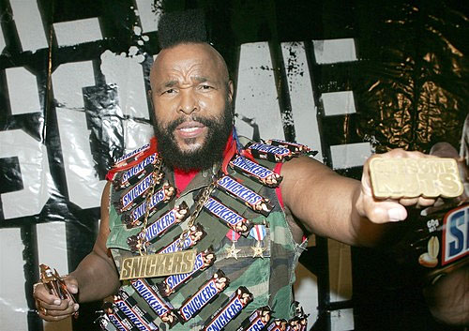
Who is this?
A. fidy cent
B. graim
C. mr t
D. mr g

Slide 19
C. 8,000 Answer
Back to Board

Slide 20
What’s William’s favourite couler
A. pink
B. yellow
C. blue
D. orange

Slide 21
D. 16,000 Answer
Back to Board

Slide 22
What’s the capital of Thailand
A. Thailand
B. Bang kok
C. nz
D. china

Slide 23
B. 32,000 Answer
Back to Board

Slide 24
Whats william’s middle name ?
A. steel
B. bla
C. bla,bla
D. bla,bla,bla

Slide 25
A. 64,000 Answer
Back to Board

Slide 26
Whats jovan’s last name?
A. hi
B. peters
C. purple
D. pimpile

Slide 27
B. 125,000 Answer
Back to Board

Slide 28
How do you spell how
A. hip
B. who
C. how
D. oh

Slide 29
C. 250,000 Answer
Back to Board

Slide 30
Whats my favret cheese flaver
A. cheese
B. cheder
C. blue cheese
D. edime

Slide 31
D. 500,000 Answer
Back to Board

Slide 32
Whats my bankacaunt number
A. 000000000000
B. 1111111111111
C. 22222222222222
D. 029567843

Slide 33
A. 1,000,000 Answer

Slide 34
Stink as bro !!!!!

Slide 35
Thanks for playing g’s

